Slide 1
Variable Selection For Discrete Competing Risks Models
Quanfeng Yang
Ecology
Institute of Zoology, CAS
yqf1983626931@163.com
June 29, 2016

Slide 2
Application
Example: Congressional careers in the USA.
R1：retirement, retire
R2：ambition, might be ambitious and seek an alternative office
R3: primary, might lose a primary election
R4: general, might lose a general election

Slide 3
This research aim is to seek for covariates probably influence the transition process of a Congressman from his first election up to one of the competing events general, primary, retirement or ambition and fit a appropriate penalized competing risk model matching the example.

Slide 4
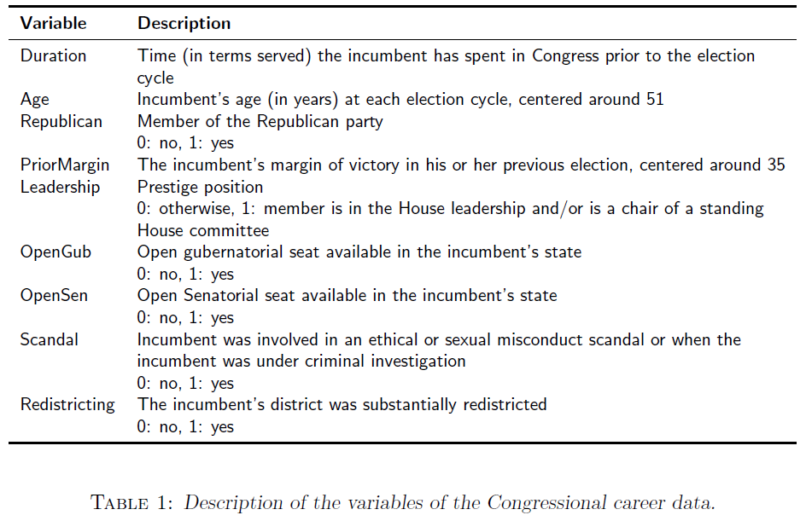

Slide 5
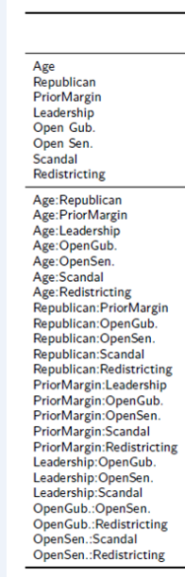
Tuning parameter: ζ1 ,ζ2
5-fold cross validation
ζ1=6.0 and ζ2=2.64

Slide 6
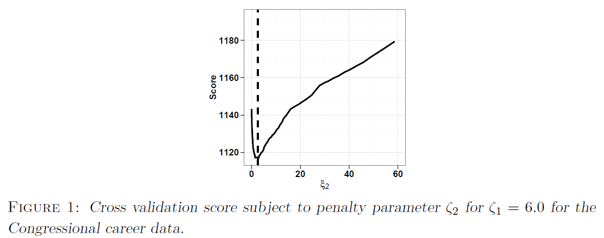

Slide 7
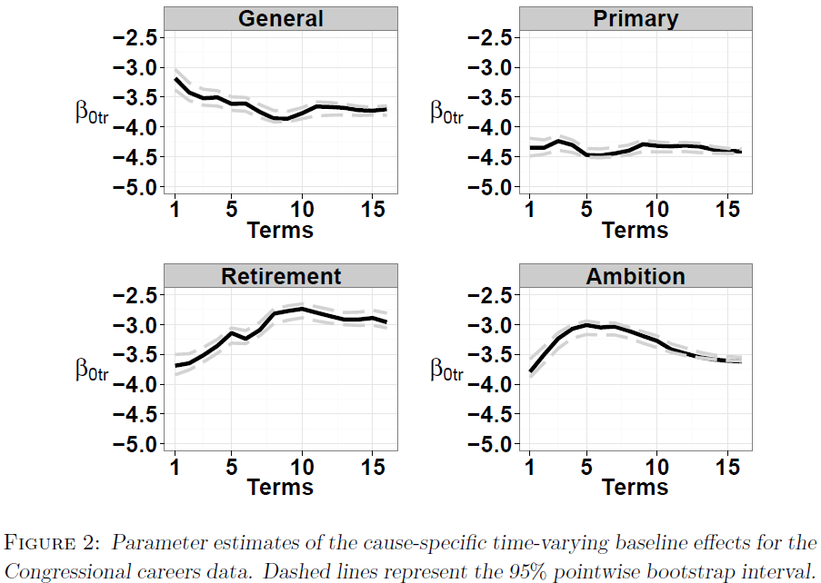

Slide 8
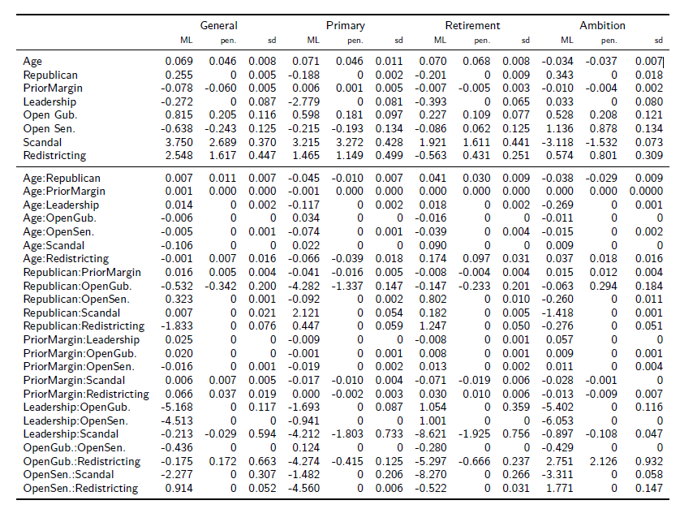
Table 2: Parameter estimates for the Congressional careers data. Ordinary maximum likelihood estimates are denoted by “ML”, the penalized estimates are denoted by “pen.”.Estimated standard errors for the penalized model obtained by a bootstrap approach are given in the columns denoted by “sd”.

Slide 9
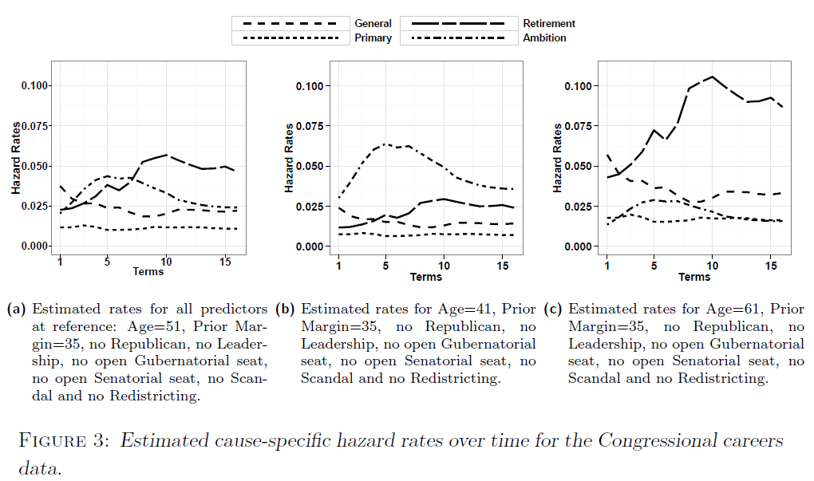

Slide 10
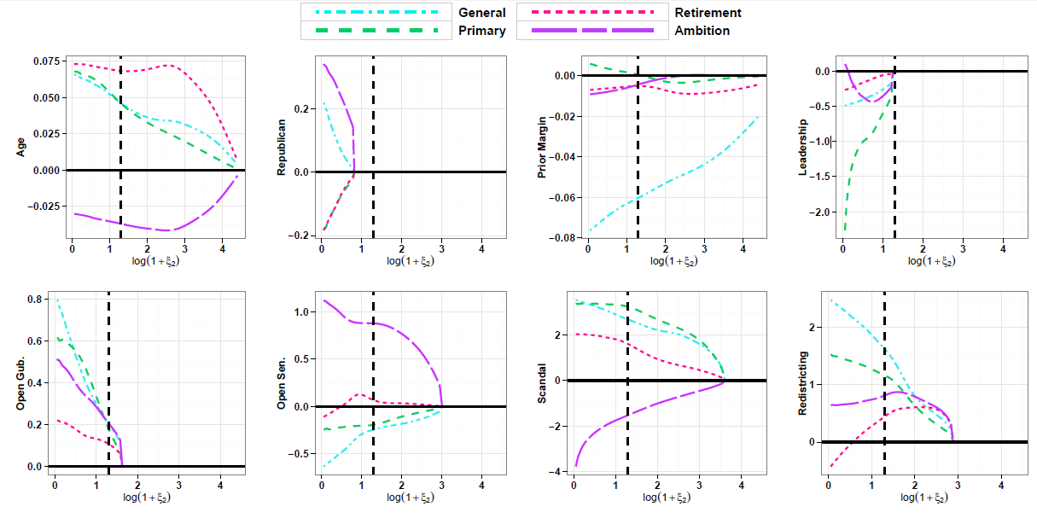
Figure 4 Coefficients paths of the main effects for the Congressional career data.

Slide 11
Conclusion
A penalized discrete competing risk model:
the cause-specific hazard rates
penalization method: to decrease parameters;
variable selection instead of parameter selection；
an additional penalty term：to avoid adjacent parameters of the baseline effects have completely different values.

Slide 12
Thank you for your listening!

